Slide 1
Scanning the Language Learning Landscape
Colin Simpson – Education Technologist

Slide 2
Acknowledging Country
I'd like to begin by acknowledging the Traditional Owners and Custodians of the land from which I come to you today, the Wurundjeri Peoples of the Kulin Nation.
I also pay my respects to their Elders past and present.

Slide 3
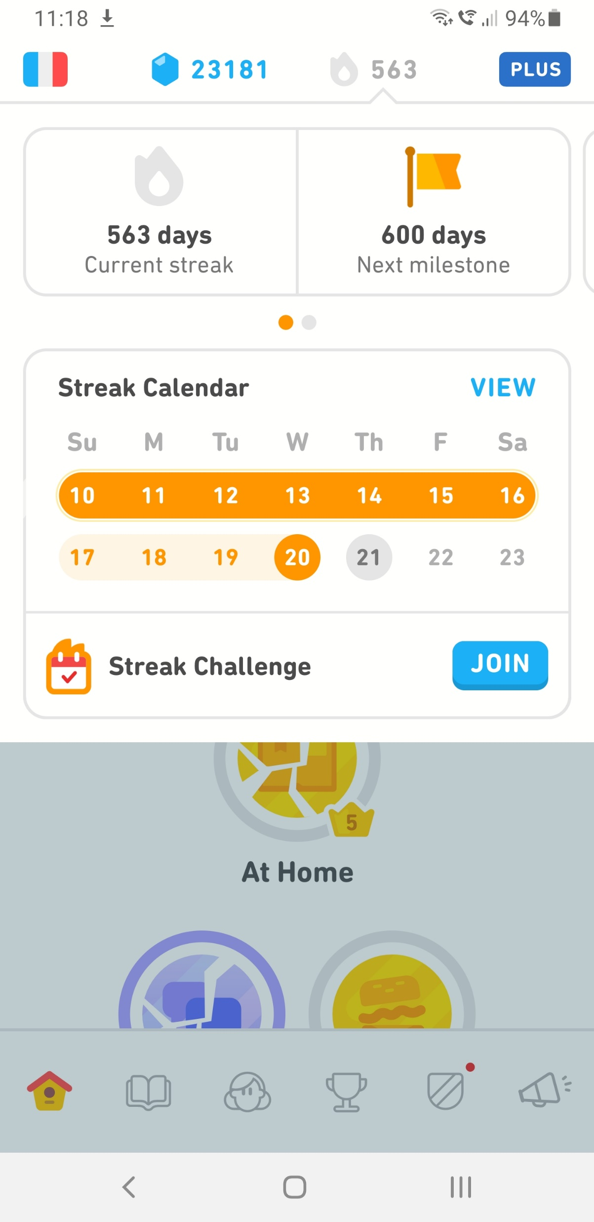
A bit about me
Things I know and have done
B.Ed (Secondary teaching – Media), M.Ed (ICT In education)
TAFE teaching
Worked extensively with educators in Tertiary sector on their use of technology in learning and teaching
Evaluate, implement and support education technologies
Mostly worked with Moodle, a little bit of Canvas and Blackboard
Weekly ed tech must-reads column in Campus Morning Mail
563 day streak in Duolingo (French)

Slide 4
A bit about you
Poll – who regularly uses an LMS?
Moodle
Canvas
Blackboard
Brightspace (D2L)
MS Teams
Google Classroom
We don’t have one

Slide 5
Listening & Speaking
TikTok – how people speak French
(7 shots in a 24 second video – 1 point per shot)

Slide 6
Listening & Speaking
Descript – Very user friendly audio/video transcription and editing

Slide 7
Listening & Speaking
Descript – Very user friendly audio/video editing

Slide 8
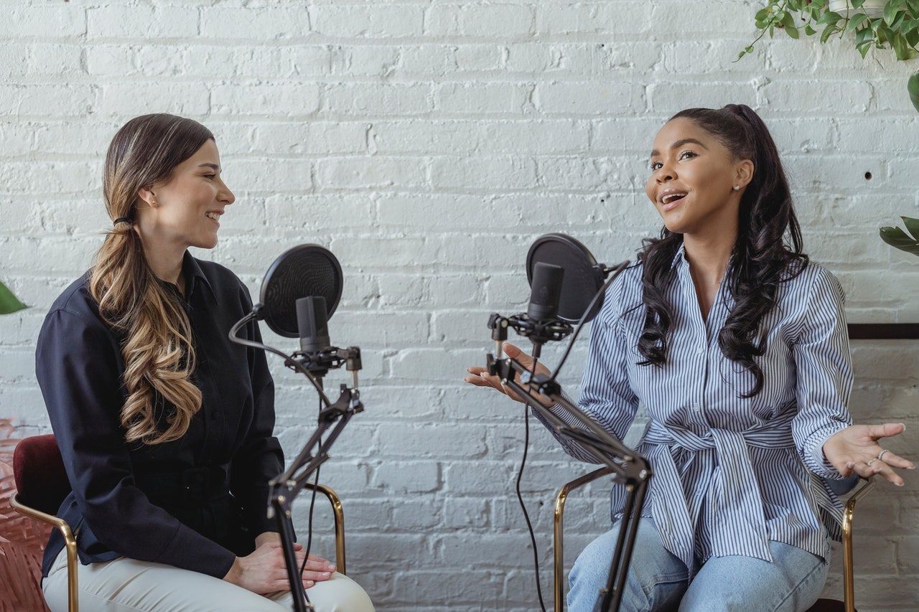
Listening & Speaking
Effects of podcast-making on college students’ English speaking skills in higher education
Long story short, it is helpful.
Metacognition – reflection and self-regulation
(planning – monitoring – evaluating – revising)
Yeh, H. C., Chang, W. Y., Chen, H. Y., & Heng, L. (2021). Effects of podcast-making on college students’ English speaking skills in higher education. Educational Technology Research and Development, 69(5), 2845–2867. https://doi.org/10.1007/s11423-021-10026-3

Slide 9
Listening & Speaking
What do you do?

Slide 10
Reading & Writing
Feedback Fruits

Slide 11
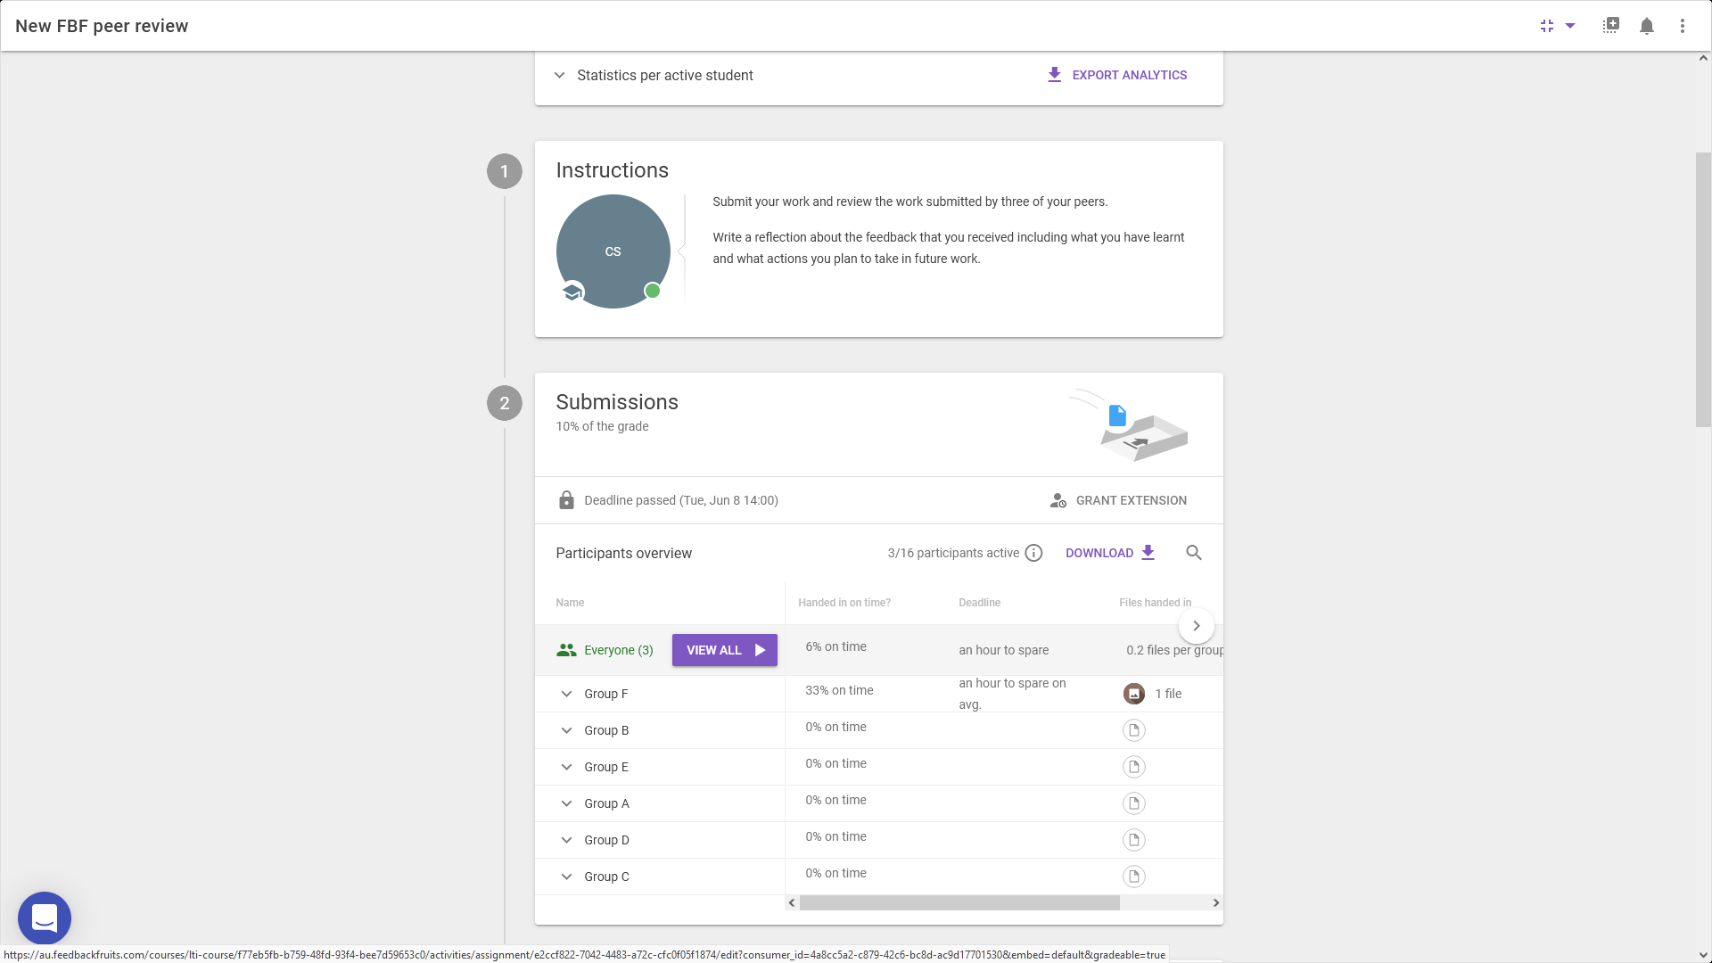
Reading & Writing
FeedbackFruits

Slide 12
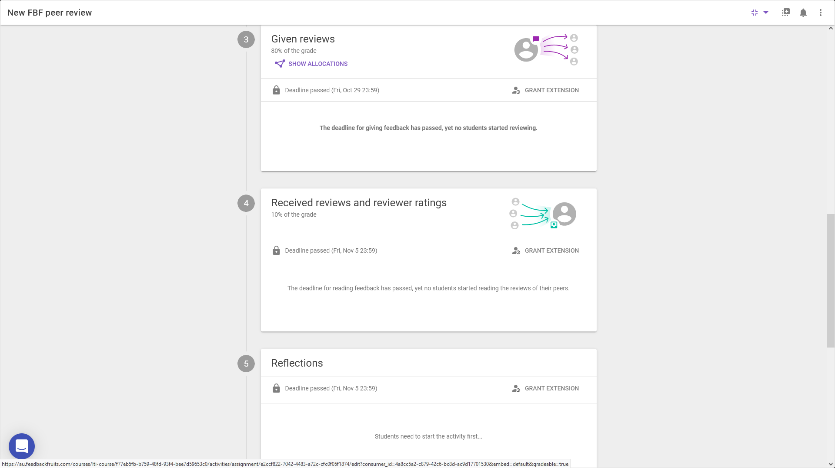
Reading & Writing
Feedback Fruits

Slide 13
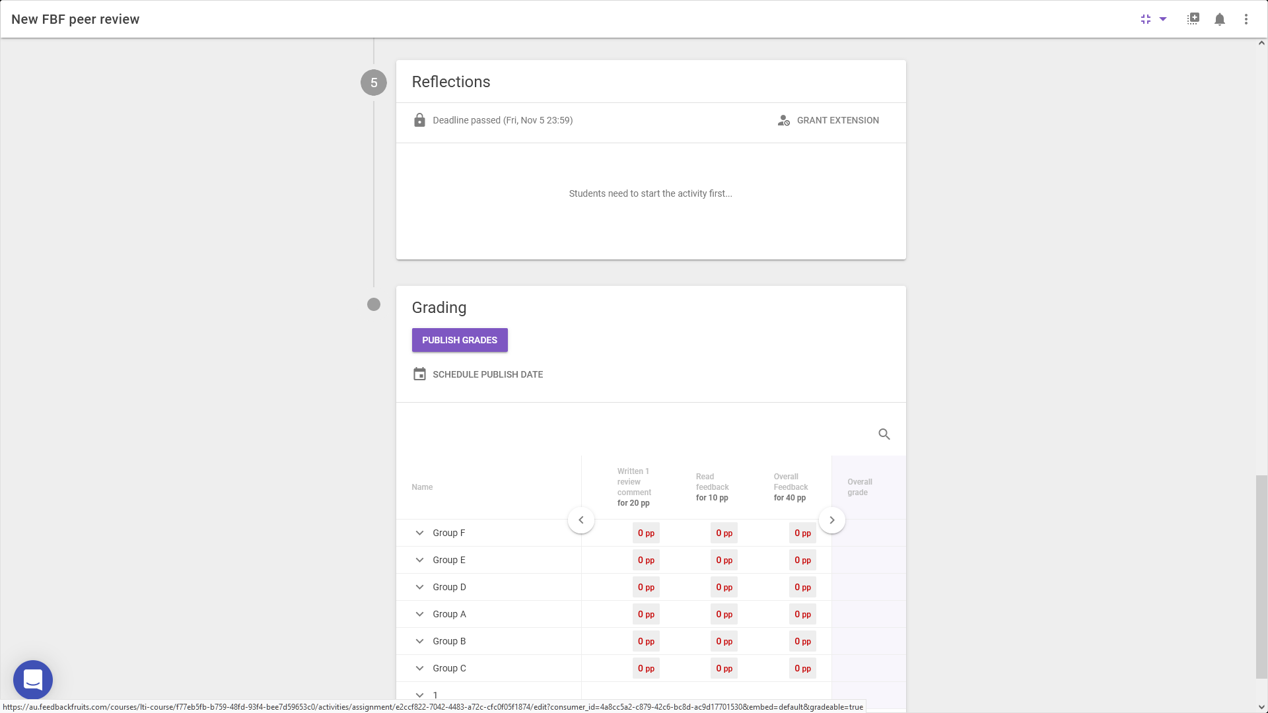
Reading & Writing
Feedback Fruits

Slide 14
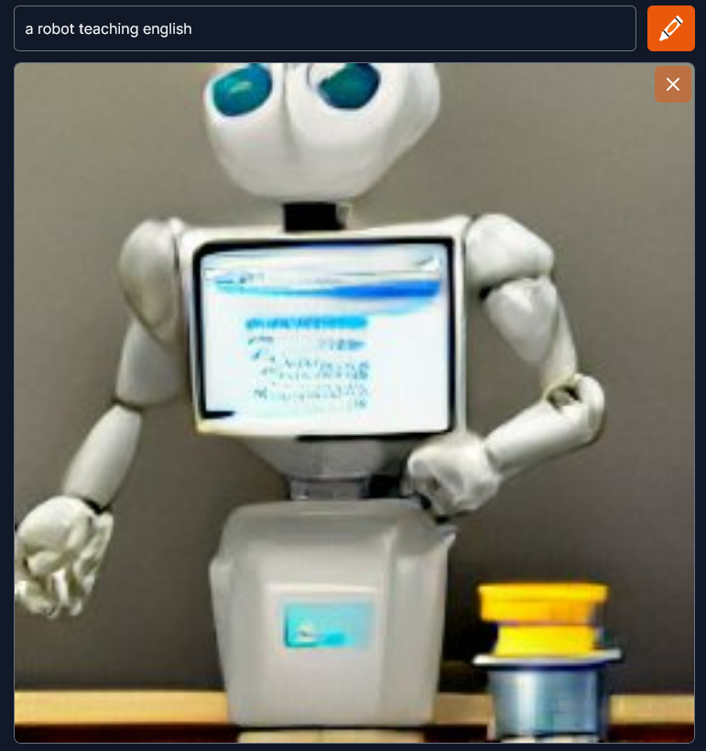
Reading and writing
AI
https://app.wombo.art/
https://creator.nightcafe.studio/
https://huggingface.co/spaces/dalle-mini/dalle-mini
https://starryai.com/
https://www.midjourney.com/
Image generated by craiyon.com

Slide 15
GPT3 from openai.com

Slide 16
Reading and writing

Slide 17
Reading and writing
Automated Essay Scoring (the robot):
Grammar (e.g., incorrect subject-verb agreement, incorrect pronouns, possessive errors)
Usage (e.g., article and preposition errors, incorrect word forms)
Mechanics (e.g., errors in capitalization, punctuation, spellings)
Style (e.g., repetitious word use)
and a selection of elements with more complex proxies such as:
Discourse structure (e.g., presence of a thesis statement, main points, length of discourse elements)
Lexical complexity (e.g., use of unusual/sophisticated words)
Sentence variety
Source use
Discourse coherence quality (e.g., extent of off-topic writing)

Slide 18
Reading and writing
Automated Essay Scoring (the educator):
Rhetorical knowledge – the ability to analyse and act on understandings of audiences, purposes, and contexts in creating and comprehending texts;
Critical thinking – the ability to analyse a situation or text and make thoughtful decisions based on that analysis, through writing, reading and research;
Writing processes – multiple strategies to approach and undertake writing and research;
Knowledge of conventions – the formal and informal guidelines that define what is considered to be correct and appropriate, or incorrect and inappropriate, in a piece of writing;
Ability to compose in multiple environments – from traditional pen and paper to electronic technologies.
Gardner, J., O’Leary, M., & Yuan, L. (2021). Artificial intelligence in educational assessment: ‘Breakthrough? Or buncombe and ballyhoo?’ Journal of Computer Assisted Learning, 37(5), 1207–1216. https://doi.org/10.1111/jcal.12577

Slide 19
Reading and writing
What do you do?

Slide 20
Wrapping up
Ask me anything
Chat to me on Twitter @gamerlearner
Find these slides in a post on my blog at https://Screenface.net

